Slide 1


Getting to know our patients and what matters: How clinicians elicit patient values, preferences, and circumstances in rehabilitation
Catherine Vingerhoets
Physiotherapist & PhD candidate
Rehabilitation Teaching and Research Unit
Department of Medicine
University of Otago

Slide 2
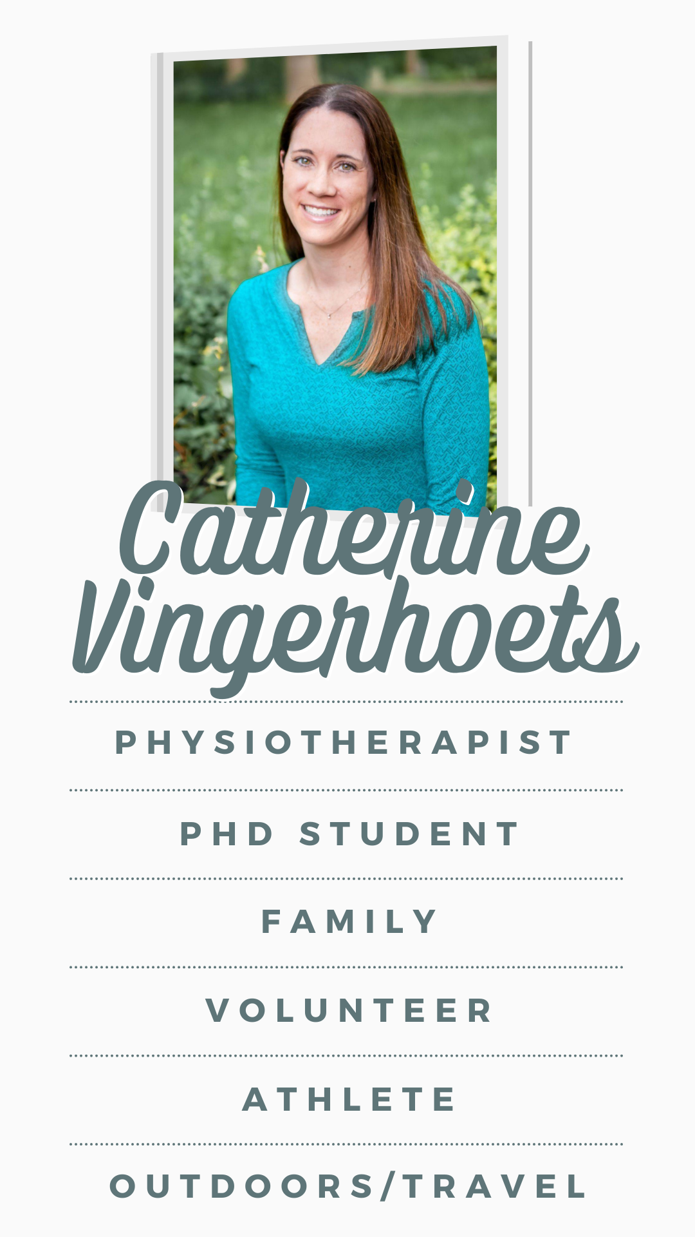
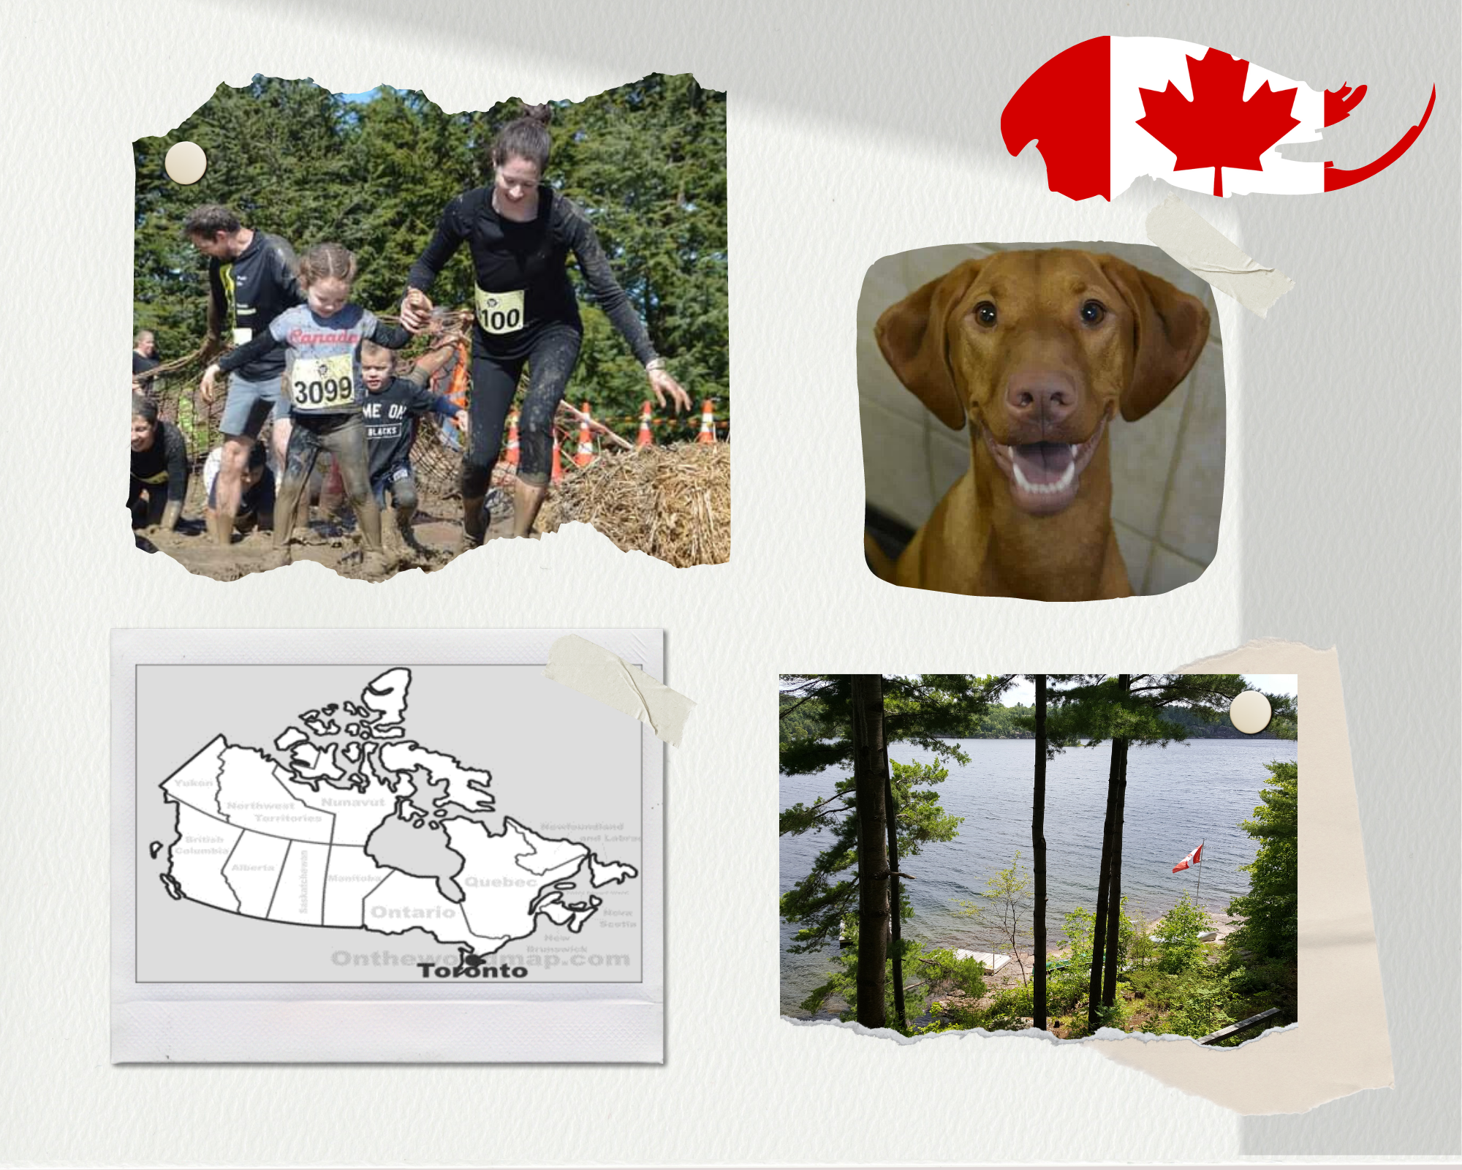
‘About Me’
© canva.com

Slide 3
Why?
*Evidence-based practice & patient-centred care*
Treatment adherence
Autonomy & satisfaction
Health outcomes
Values
Preferences
Circumstances
© Copyright PresentationGO.com
Notes:
*PCC and EBP link = PVC
*well-established that clinicians should integrate PVC, little direction on how this is done in clinical practice

Slide 4
Research Objectives
Understand HOW (Elicit)
Understand HOW (Share)
Explore understanding
© Copyright PresentationGO.com

Slide 5
Who and How?
Who
13 health professionals
7 disciplines from IP teams
PT, OT, SLT, RD, SW, MD, RN
4 inpatient neuro rehab wards
3 organizations
How
Interviews
Zoom (10) and in-person (2)
Qualitative description & inductive coding
© Copyright PresentationGO.com

Slide 6
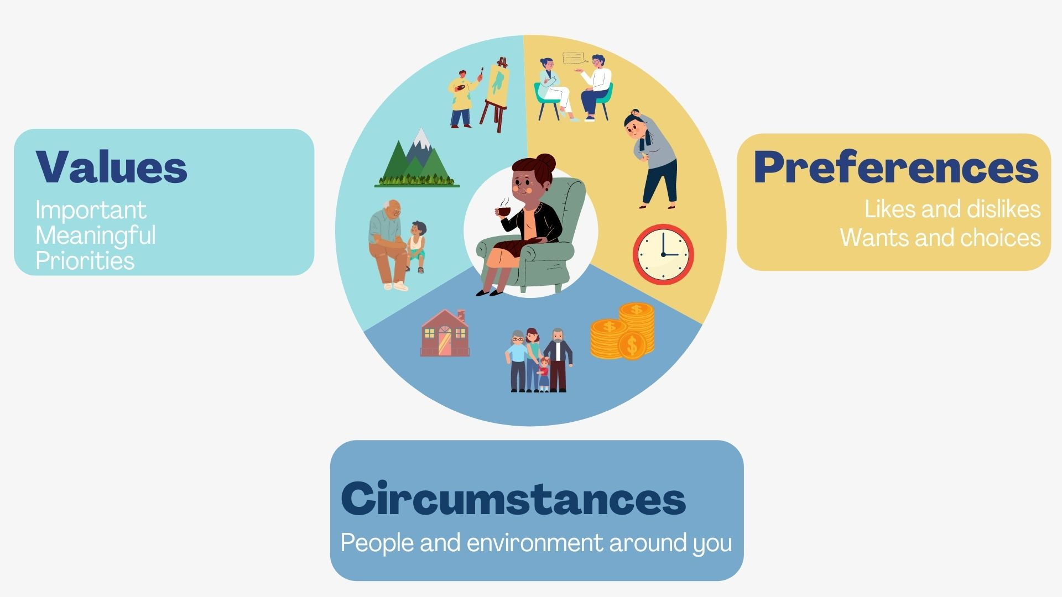
© Catherine Vingerhoets
Notes:
Values
What is important/meaningful to patient/family
What matters, motivating, priorities
E.g. culture, family,
Preferences
Likes/dislikes, choices, wants/needs, goals
E.g. process or environment
*Process-receiving information and feedback, therapeutic activities and priorities for therapy sessions, communication, and aspects of daily routines such as the timing of medication and rest.
*Environment- preferred location of rehabilitation (e.g., community vs. inpatient), discharge destination, and the physical environment within the rehabilitation setting, such as their room set-up.
Circumstances
Physical, social, environmental context
Past (PMH, home env)
Present (functional status, rehab env)
Future (social support, care needs on D/C)

Slide 7

Values
Preferences
Circumstances
“It’s all the stuff …hard to quantify … helps shape the impression you get …and what you see for their rehab journey”
* Overlapping
* ‘Grey’ or ‘in-between’
* Value(s)
Notes:
-overlap
-not thought about
-circumstances (easiest), values (most difficult)
‘grey’ or ‘in-between’ info
“It’s all the stuff you probably find hard to quantify when you’re working with a person that helps shape the impression you get of the person and what you see for their rehab journey”

Slide 8
Elicitation of values, preferences, & circumstances (WHAT)
Structure/ Source | Patient Direct | Patient In-direct
Formal | Standardised tools or outcome measures Goal-setting Organizational-developed tools | Family meeting Team meetings Clinical documentation
 | Developing a picture Group activities/stories Observation Informal discussions | Spending time with family Informal clinician discussions
Informal
Notes:
*Formal-structured processes that elicit values, preferences, and/or circumstances, although this may not be their primary purpose.
*well-recognized rehabilitation processes such as goal setting, family meetings, interviewing, and use of standardized tools and outcome measures (e.g., Goal Attainment Scale or values-based questionnaires),team meetings, clinical docs
*Informal-information is revealed through opportunities that were spontaneous.
*intuitive rather than explicit, uncovered incidentally.
*spending time with the patient and their family, seeing the person as a whole, and informal discussions during therapy or activities.
*groups or telling stories often shared valuable information about their values, preferences, and circumstances, especially if those activities were outside of the ‘typical therapeutic realm’ (e.g., social opportunities or community activities).
*power of observation was noted by several clinicians who felt that valuable information was gleaned from watching patient/family dynamics during interactions and home visits, as well as observing patient body language, cues, and behavioural responses, especially if they were unable to communicate verbally.
*Informal conversations between health professionals and conducting joint care or therapy sessions were other informal
*tools developed by institutions to explicitly gather this information- “About Me” book or “Life Before Stroke” form -interests, pre-admission functional status, family, important things
*Link back to intro slide

Slide 9
‘About Me’
© canva.com

Slide 10
Sharing of values, preferences, and circumstances (communication)
Formal
Informal
Interprofessional meetings
Clinical documentation
Communication tools
Formal verbal communication
Opportunistic discussions
Phone calls
Emails
Posted information
Common data sharing tool
© Copyright PresentationGO.com
Notes:
Communication also formal/informal
* Formal= obvious
* Informal= valuable opportunities

Slide 11



The processes of elicitation and communication (HOW)
It takes a team
Flexibility is key
.
All within a context
Relationships matter
© Copyright PresentationGO.com

Slide 12


It takes a team
“Our processes … not actually that linear… our own approach…we approach things differently, because we have different backgrounds, and we have different professional values.”
“No matter how good you are at trying to understand …you’re never going to understand it as well as a family member.”
* Patient/family/
team
* Conflict/tension
* Professional perspectives
© Copyright PresentationGO.com
Notes:
“No matter how good you are at trying to understand what a person enjoys and what life was like before they came into hospital and what they value and what they love to do and what’s important to them, you’re never going to understand it as well as a family member.”
“Our processes around gathering this kind of information and setting goals is not actually that linear, and I think we all, as separate professions have our own way of attacking that, or our own approach, and I even think between myself and the other OT we approach things differently, because we have different backgrounds and we have different professional values.”

Slide 13
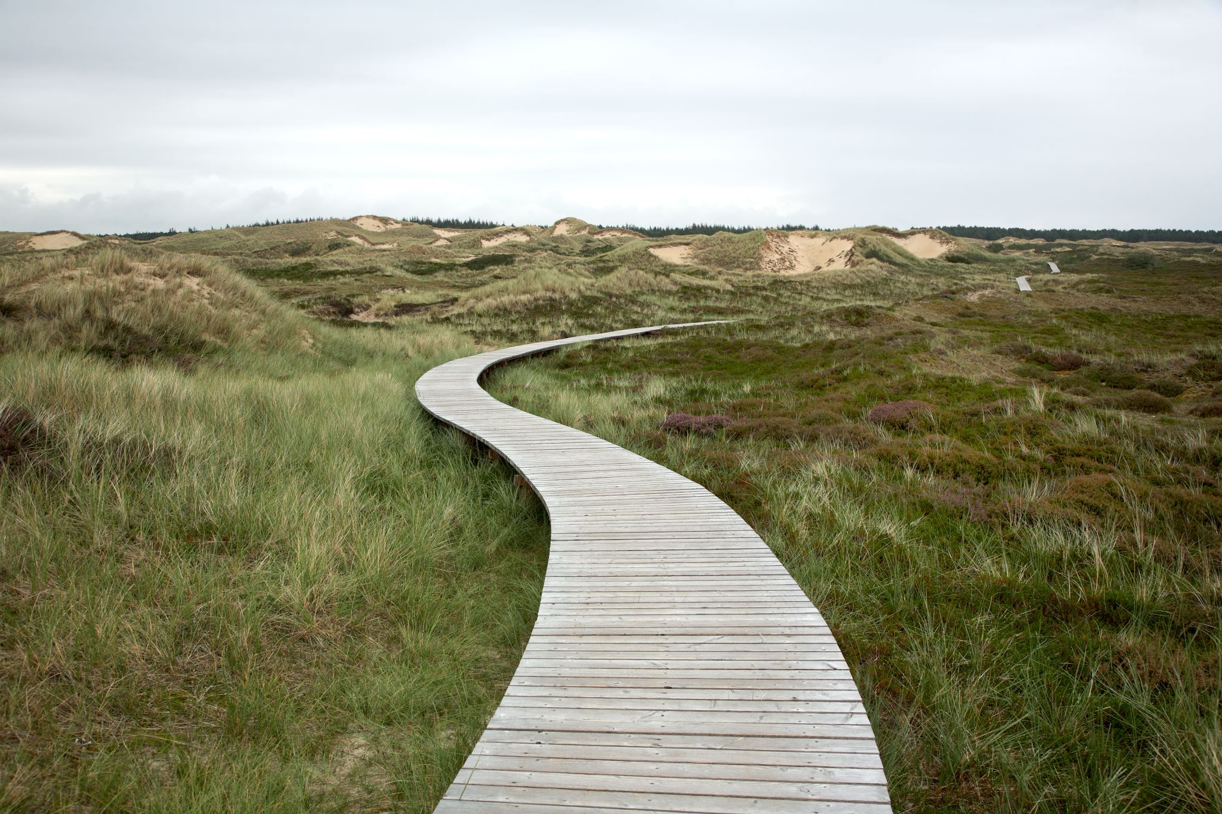
Flexibility is key
“the kind of things that over time you can pass on to other clinicians, to students, to staff members that you supervise… But it's casual, it's in story form, it's in examples”
“The way that you can adapt your language…to suit the person, matters… Do they like to have a really structured sit-down conversation, do they like a walking-talk in the corridor?”
*Different ways/sources/times
*Tailor/adapt/modify
*Evolve/change
*Gradual/over-time
© Copyright PresentationGO.com
Notes:
“The way that you can adapt your language and adapt your questioning to suit the person that you're asking it to, matters. Like trying to understand how the person that you're speaking to communicates. Do they like to have a really structured sit-down conversation, do they like a walking talk in the corridor?”
Some clinicians felt that elicitation skills were “the kind of things that over time you can pass on to other clinicians, to students, to staff members that you supervise… But it's casual, it's in story form, it's in examples”

Slide 14

Relationships matter
“You're wanting to make the person feel heard and … they can trust you…because you're hoping that they can feel safe enough with you to talk about very personal stuff...”
“All of a sudden something's happened … outside of their control… trying to give people something that they can feel like they're driving, and something that they can be in control of…”
*Support, reassurance,
empathy, rapport,
communication, trust
*Power
*Team relationships &
culture
© Copyright PresentationGO.com
Notes:
“You're wanting to make the person feel heard and feel that they can trust you, because you're hoping that they can feel safe enough with you to talk about very personal stuff. None of us want to do that with someone that we don't feel really cares about us and that we can trust.”
All of a sudden something's happened that's often outside of their control. And it's such a massive turning point for people in their lives… trying to give people something that they can feel like they're driving, and something that they can be in control of, I think is really important

Slide 15

All within a context
“If we don't keep the overall goals in mind, we'll become just discharge-focused and process-focused, and we lose what's important for the patient…”
*Patient, organization,
environment
*Patients’ culture
*Organizational
values/priorities
“…you see a pile of shoes at the front door…you might not even need to ask, ‘should I take my shoes off at the door?’ You just do it because you can see that’s obviously part of the expectation…”
© Copyright PresentationGO.com
Notes:
*Patient’s cultural identity-diverse perspectives
*identify/accommodating, others didn’t feel culture influenced practice or no robust process
*biculturalism, extent of perceived responsiveness differed. *tried to incorporate Māori values and preferences-processes could be improved *Admission questions, interpreter, MHN
“Even down to something basic like if you’re doing a home visit and you see a pile of shoes at the front door … you might not even need to ask, ‘should I take my shoes off at the door’? You just do it because you can see that’s obviously part of the expectation for what’s normal for that person and trying to kind of fit in and respect that wherever possible. “
*Org values/priorities influence elicitation
“If we don't keep the overall goals in mind, we'll become just discharge-focused and process-focused, and we lose what's important for the patient. So there have been some systemic things that have pushed us away from goals, even though they [the organisation] would say the institution values goals.”

Slide 16
Key Takeaways
Relationships
WHAT + HOW
Team
Value of ‘Values’
Flexibility
Shared understanding
Context
(patient, organization, environment)
© Copyright PresentationGO.com
Notes:
*strategies used (what clinicians did) and the approach applied (how they did it) were both essential to the effective elicitation
*processes of eliciting and communicating PVC influenced by relationships
*relied on contribution from many people
*required a flexible and adaptable approach that was tailored to the individual patient and their context
*Shared understanding of these terms/processes
*Recognition of value of info in CP
*Vital for providing holistic, empowering & truly PCC rehab

Slide 17


That’s not the end of the story…
“It’s very easy to see someone in bed…they’ve had a dense stroke and you think ‘there wasn’t a life before stroke’. They’re a person with a stroke, in bed, and we all come with a history. It’s unpacking it really and finding out what’s important.”
This Photo by Unknown Author is licensed under CC BY-SA

