Slide 1


Using Enabling Good Lives principles in research
Emily Timothy
Dr Jo Deely, Dr Jo Nunnerley and the Co-design team
June 2023
Investigating navigational support after stroke
Notes:
Intro to me (stroke important topic to me) and team
Acknowledge HRC funding

Slide 2
Ko te tūmanako me haere tahi tatou
Let us do this together
Notes:
Acknowledge the intent of EGL to shift power and authority from government to disabled people and their families

Slide 3
Where we started
People feeling unsupported, unsure and having to drive rehabilitation/life after stroke myself/ourselves.
I think it would have been useful just to have someone who was a name or a contact, that if I was struggling, I could get hold of, so when I realised that things had gone wrong, there was no way then I had of reaching out to talk to someone (person with stroke)
I’m not sure what I should expect, whether I’ll get more rehab at that time, or whether they will just only be responsive, not proactive, or if there maybe should be something that I’m asking for, but I don’t know what to ask (person with stroke)
This depends on my/our knowledge, my/our outlook and my/our supports
Is this equitable?
Where is the control?
Could it be better?
Notes:
Suggestions from interviews on EVOCs that people felt they had to navigate their own rehab
Links in projects and listening to the voices Ha-I-mano

Slide 4
Investigating navigational support for people living with stroke
Establish co-design team
Focus groups
Workshop to establish principles/recommendations
Enabling Good Lives and
Whānau Ora
principles
Notes:
Focus on Otautahi.
Secondary analysis interviews – thematic analysis
Co-design team: inc maori and pasifica PLEx and whanau plus stroke Foundation and researchers
2 focus groups
Cumulative approach

Slide 5

Why EGL and Whānau Ora?
Evidence based
Relevant to the people of Aotearoa
“Why not just replicate/extend the model???”
Capture the diverse needs of people with stroke within the context of existing services in Ōtautahi
Notes:
EGL centred on the ‘person, their strengths and aspirations’, and it’s an approach that works, as we’ve seen in the pilot regions. It enables disabled people and their family/whanau to have much more choice and control over their own lives and the supports they receive.
Demonstrations showed improved outcomes when disabled people, families and whānau have that choice and control over their supports and access.
Not about WO today but want to acknowledge the overlap….
Whānau ora is driven by a focus on whānau being self-managing, living healthy lifestyles and confidently participating in te ao Māori and in society.
The Enabling Good Lives (EGL) approach is also about whanau ora (improving family wellbeing, focusing on the family as a whole, and addressing individual needs within the context of the family) but it is not explictly kaupapa maori.

Slide 6
Core principles
Self-determination
Person-centred
Beginning early
Ordinary life outcomes
Mainstream first
Mana enhancing
Easy to use
Relationship building
Notes:
Echo of Tom's presentation

Slide 7

Voices we heard
Notes:
Semi structured interviews and focus groups. We asked questions to gain depth of understanding and this included clarifying where EGL principles fit it.
Open questions and explicit clarification of principles eg....should navigators be allocated the person/whanau and essentially 'lifelong' or should they be stroke specific?

Slide 8
Relationship building
..it’s whanaungatanga and manaakitanga, and holding space for whānau to navigate... So we will connect, and the more time we spend with people the more that our kaitūhono know how to connect those dots. (service provider)
…you went and had physical therapy one day and came back and there was some Stroke Foundation literature on the bed and we just knew immediately that if they don’t understand kānohi ki te kānohi they won’t work for us…we just knew they just weren’t going to work for us. It’s just like looking at a pair of shoes that are not the kind of shoes you’d ever put on. That’s what it was like. (whānau of person with stroke)

Slide 9
Self-determination
It’s having those tools to navigate…it’s a bit like you’re given a map but you don’t know which way’s north and you need your compass and a key to what things on the map mean. Sometimes it feels like health professionals think they’ve given you, they go ‘oh here’s the map’ but they don’t provide a guide of what the lines mean. (person with stroke)
[Promoting] self-empowerment skills to enable better life participation (such as TACAS [Take Charge After Stroke], but not limited to formal programmes, but should be embedded in all rehab by all staff), rather than create dependency on therapists (service provider)

Slide 10
Person-centred
as soon as you have a specific [health condition navigator] then that becomes the focus, which leads you into biomedical. If you have a general [navigator] who’s doing a great job as a tūhono they won’t need the knowledge because all of the knowledge will be taken in and shared (service provider)
I think my final thing would be not to make [navigational support] complicated. The easy questions, whatever it looks like, whatever the job title is and wherever they sit, is just to be a kind, good person to the family and have some empathy. Kindness and empathy is really… everything else can get taught and the family will teach. Sometimes we try and do these amazing big ops manuals and really just… let it grow. (service provider)
Easy to use

Slide 11

How our co-design team used EGL
Influenced;
Questioning
Analysis
Workshop synthesis
Notes:
Brought together all key themes identified to date plus all the principles of EGL and WO and prioritised in terms of low, medium, high priority

Slide 12

Findings
Notes:
Focus of overarching principles but also explicit recommendations – not going into these today

Slide 13
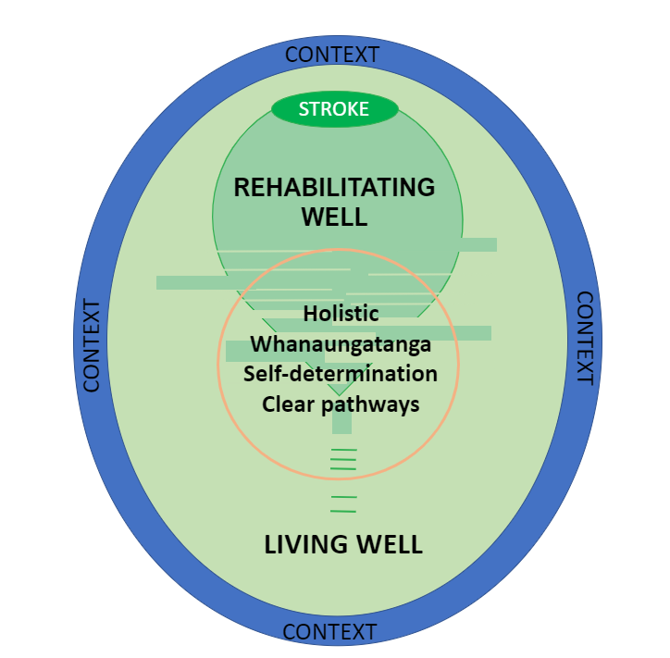
Whānau are self-managing and empowered leaders
Whānau are participating in society
Self-determination
(Option for) Beginning early
Person-centred
Easy to use
Relationship building
Notes:
Visual representation of how services should best support people after stroke
GREEN – journey with shift from rehab well to living well – the 2 intertwine
RED CIRCLE: These principles relate to Te Whatu Ora staff, existing navigator services (SF included) and prospective navigator roles/partnerships
Whanaungatanga = build a relationship through shared experiences and working together with a person and their whānau which provides a sense of trust and belonging.
Self-determination refers to a person's ability to make choices and manage their own life. Being self-determined means that you feel in greater control, as opposed to being non-self-determined, which can leave you feeling that your life is controlled by others.
Mainstream first and ordinary life outcomes did not feature highly in this

Slide 14
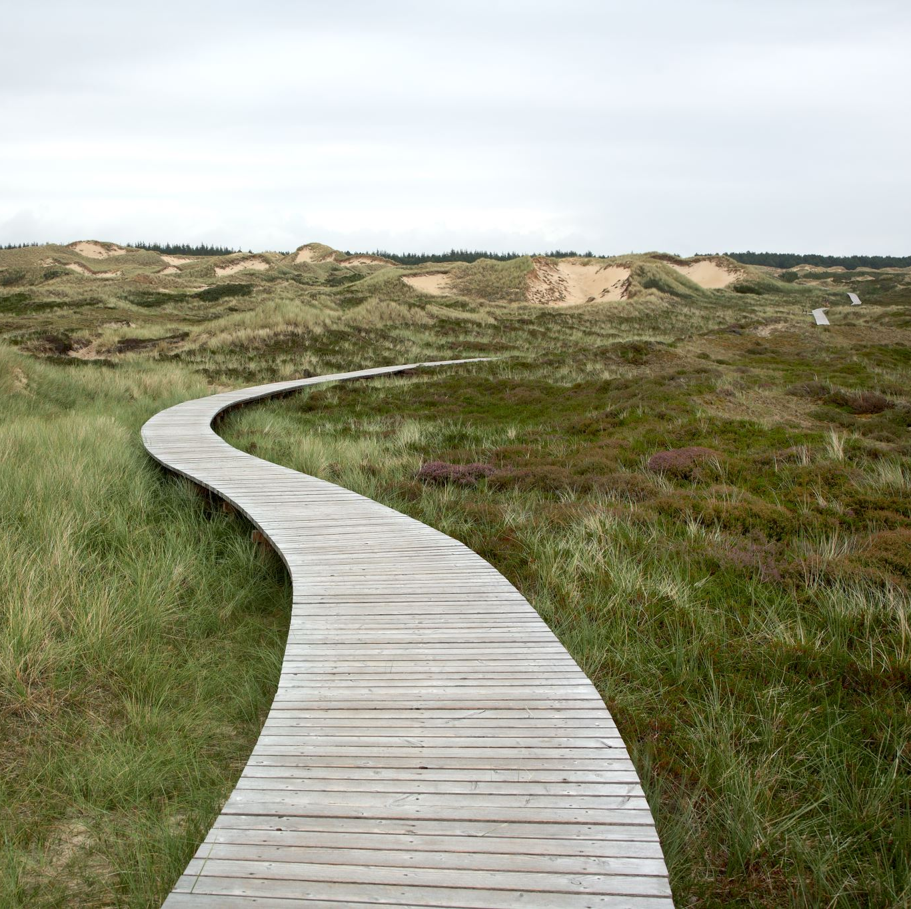
Next steps
More conversations with stakeholders​
Further funding application if appropriate​
Reflections on process
Your thoughts.....?
Notes:
Recognise lots of concurrent pieces of work happening that are moving us in a similar direction eg. Stroke Foundation, Whaikaha

