Slide 1
Enabling Good Lives
Tom Callanan and Nicholas Tung

Slide 2

Vision
Disabled people and their families will have greater choice and control over their lives and supports, and make more use of natural and universally available supports.

Slide 3

Principles
Self-determination.
Beginning early.
Person-centred.
Ordinary life outcomes.
Mainstream first.
Mana enhancing.
Easy to use.
Relationship building.

Slide 4

Enabling Good Lives Christchurch
Small demonstration began in 2013
Only ORS funded school students and leavers are included.
Planning time with EGL connectors/kaitūhono
Flexible personal budget
Other examples of EGL approach

Slide 5
Enabling Good Lives Principles in our practice

Slide 6
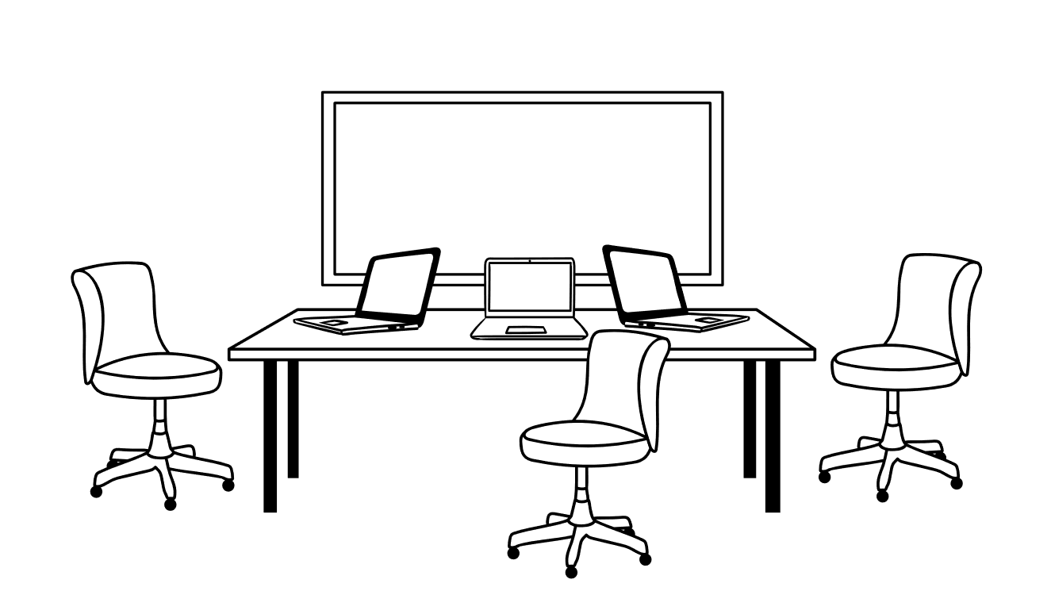
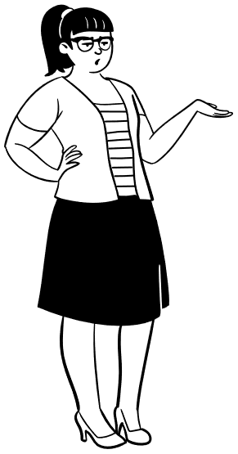

Day Services? Or...
My product: Art kits

Slide 7


Residential care? Or...

Slide 8

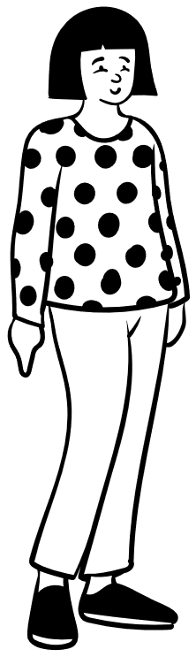

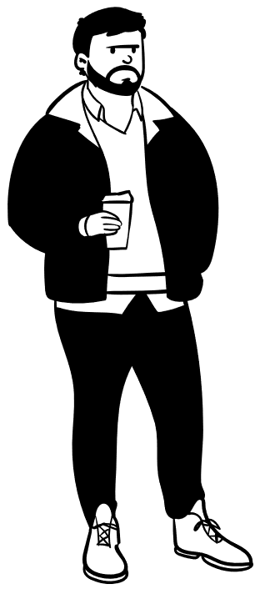
Manage Staff? Or...

Slide 9


Community Development Current Priorities/Challanges

Slide 10

Employment
Pathways to access mainstream employment.

Slide 11

After school Opportunities
Alternatives options to residential/day services

Slide 12

Housing
More opportunities for disabled people to access housing.

Slide 13

Incorporating the Enabling Good Lives approach
Consistency, speed, and personalised.
Community awareness of the Enabling Good Lives approach.

Slide 14
Principles
Self-determination.
Beginning early.
Person-centred.
Ordinary life outcomes.
Mainstream first.
Mana enhancing.
Easy to use.
Relationship building.

Slide 15

Questions?

Slide 16

Connector/Kaitūhono
An ally who assists a disabled person and their family to dream big, make a plan for the future and connect with their local community.

Slide 17

Flexible Personal Budget
Based on your plan for a good life
Flexibility around how you receive funding and what you use it for
No more funding, but more choice and control over how resources are used
Notes:
- Based on your plan for a good life (rather than traditional needs assessment).

Slide 18
Traditional Funding
EGL Personal Budget
Ministry of Education Funding
ORS
(If you leave school before 21)
Ministry of Social Development Funding
Transition
Single personal budget
Community Participation
(High ORS equivalent after 21)
Very High Needs Funding
(V High ORS equivalent after 21)
Whaikaha Funding
Carer Support
Individualised Funding
Personal Care
Home Support
Household Management
Respite
Supported Independent Living
Resident Family Care
Notes:
EGL PBs allow for all disability support funding streams to be pooled into a single budget that can be used for any type of support that suits the needs of the individual with more flexibility.
But emphasize the PLAN!
Where traditional funding allocations had left little islands of funding for specific purposes in most cases not allowing one type of allocation to be used for another’s purpose, an EGL PB does not limit a person in the same way.
Recognising that needs are not uniform for a whole year, having the ability to use less or more of different supports empowers people the live the way they choose.

Slide 19

Contact Details
General enquries
Email – info@eglives.co.nz
Ph / Txt: 0800 225 570
Tom Callanan (Community Lead)
Email: community@eglives.co.nz
Ph / Txt: 021 228 2658

